Slide 1
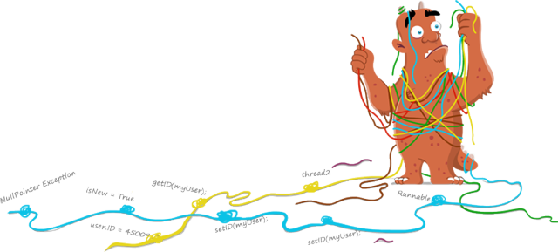
Debugging Memory Leaks
By,
Benhur Davies

Slide 2

Debugging
Debugging is a science of investigating methodically the reason for software misbehavior
Debugging tool are merely used to generate the data and to probe the data that is needed for the root cause analysis.
Successful debugging depends on identifying the right data for root cause analysis, identifying the right tools to use and identifying what to probe for at each step.
So the Most powerful debugging tools – Attitude & Brain !!!

Slide 3

.NET Memory Management Concepts
Memory Allocation
Garbage Collection
Analyzing GC Roots
Generations
Large Object Heap
Fundamental of Finalization

Slide 4
Memory Allocation
Garbage Collector (GC) is the part of the .NET framework that allocates and releases memory for your .NET applications.
When a new process is started, the runtime reserves a region of address space for the process called the managed heap.
Objects are allocated in the heap contiguously one after another.
Memory allocation is a very fast process as it is just the adding of a value to a pointer.
In addition to the managed heap, an app always consumes some amount of so-called unmanaged* memory which is not managed by GC.
*Generally, it is required by .NET Common Language Runtime itself, dynamic libraries employed by the app, graphics buffer, and so on.

Slide 5

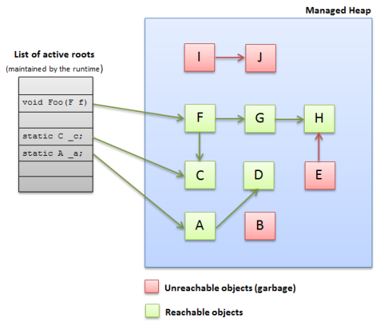
Garbage Collection
The process of releasing memory is called garbage collection.
When GC performs a collection, it releases only objects that are no longer in use by the application (for example, a local variable in a method can be accessed only during the method execution and after this, the variable is no longer needed).
To determine whether the object is used or not, GC examines application’s roots - strong references that are global to the application. Typically, these are global and static object pointers, local variables, and CPU registers.
For each active root, GC builds a graph that contains all the objects that are reachable from these roots.
If an object is unreachable, GC considers it no longer in use and removes the object from the heap (releases the memory occupied by the object).
After the object is removed, GC compacts reachable objects in memory.

Slide 6

Analyzing GC Roots
Retention path of an object always starts with a GC root
Roots the only possible starting point for building retention graphs
Understanding root types can be extremely important in the "Who retains the object?" analysis
Sometimes, examining retention paths does not give you an answer why the object is still in memory. In this case, it makes sense to look at GC roots. Eg: The handle gives you a clue that the object is retained by some unmanaged COM library.

Slide 7

Possible roots in .NET Framework
Stack references - references to local objects. Such roots live during a method execution.
Static references - references to static objects. These roots live the entire app domain life time.
Handles - typically, these are references used for communication between managed and unmanaged code. Such roots must live at least until the unmanaged code needs "managed" objects.
Finalizer references - references to objects waiting to be finalized. These roots live until the finalizer is run.

Slide 8
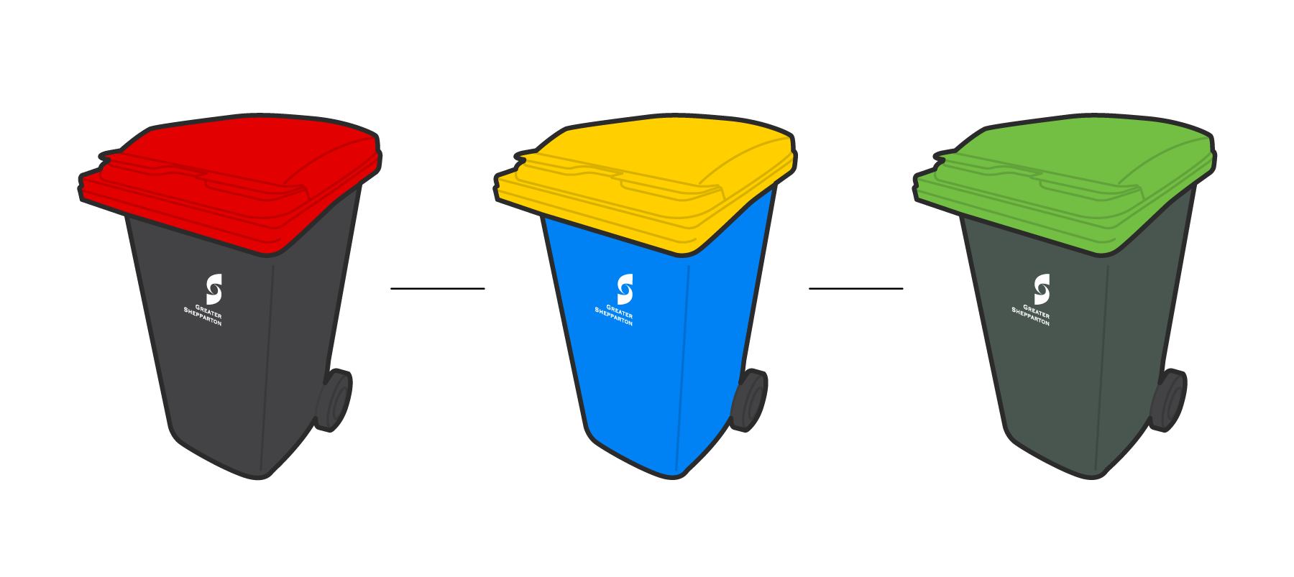
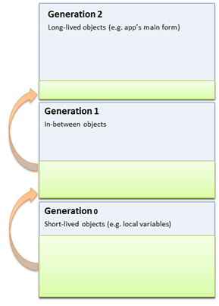
Generations
For better performance of memory release, the managed heap is divided into segments called generations: 0, 1, and 2.
When objects are just created, they are placed to the Generation 0 (Gen 0).
When Gen 0 is full (the size of the heap and generations is defined by GC), GC performs a garbage collection. During the collection, GC removes all unreachable objects from the heap. All reachable objects are promoted to the Generation 1 (Gen 1).
The Gen 0 collection is a rather quick operation.
When Gen 1 is full, the Gen 1 garbage collection is performed. All objects that survive the collection are promoted to Gen 2. The Gen 0 collection also takes place here.
When Gen 2 is full, GC performs full garbage collection. First, Gen 2 collection is performed, after this, the Gen 1 and Gen 0 collections take place. If there is still not enough memory for new allocations, GC raises the OutOfMemory exception.
During full garbage collection, GC has to pass through all objects in the heap, so, this process might have a great impact on system resources.

Slide 9

GC runs when ?
Gen 0 objects reach ~256 K
Gen 1 objects reach ~2 Meg
Gen 2 objects reach ~10 Meg
System Memory is low

Slide 10

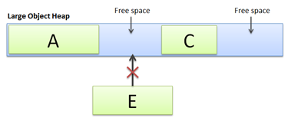
Large Object Heap
Due to performance reasons, large objects (>85KB) are stored in a separate segment of the managed heap called Large Object Heap (LOH).
Survived objects in LOH are not compacted*. This means that LOH becomes fragmented over time.
*Starting from .NET Framework 4.5.1, you can force GC to compact LOH during the full garbage collection.
GCSettings.LargeObjectHeapCompactionMode = GCLargeObjectHeapCompactionMode.CompactOnce;
GC.Collect();

Slide 11

Fundamental of Finalization
Finalize is a special method that is automatically called by the garbage collector (GC) before the object is collected
Destructor in C# are automatically translated into Finalize.
You can see the IL code using IDASM where you will see that destructor is renamed to finalize.
public class A{
~A()
{
Console.WriteLine("Class A Destructor");
//Clean up unmanaged resources here
}}
The CLR translate the C# destructor
public override void Finalize()
{
try
{
Console.WriteLine("Class A Destructor");
//Clean up unmanaged resources here
}
finally
{
base.Finalize();
}
}

Slide 12

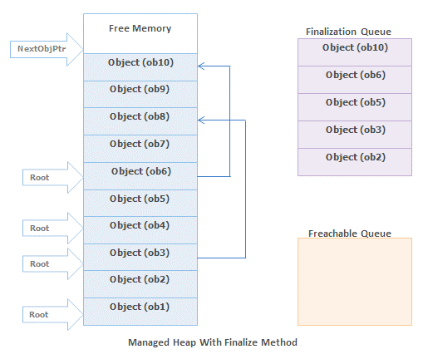
Finalization Queue
If newly created object have a Finalize() method or a destructor then a pointer pointing to that object is put into the finalization queue.
Finalization queue is an internal data structure that is controlled and managed by the GC
Before the collections for dead objects, the garbage collector looks into the finalization queue for pointers identifies these objects
If the pointer found, then the pointer is flushed from the finalization queue and append to the freachable queue

Slide 13
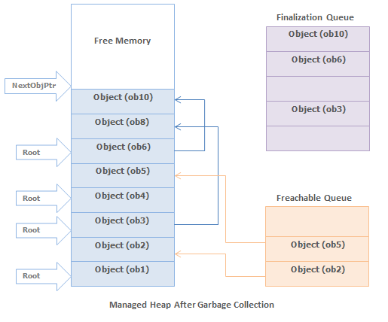
The freachable queue is also an internal data structure and controlled by the garbage collector
When an object's pointer entry move from the finalization queue to the freachable queue, the object is not considered garbage and its memory is not reclaimed.
There is a special run-time thread that is dedicated for calling Finalize methods.
When there is no entry in the freachable queue then this thread sleeps. But when there is entry in the freachable queue, this thread wakes and removes each entry from the queue by calling each object's Finalize method.

Slide 14

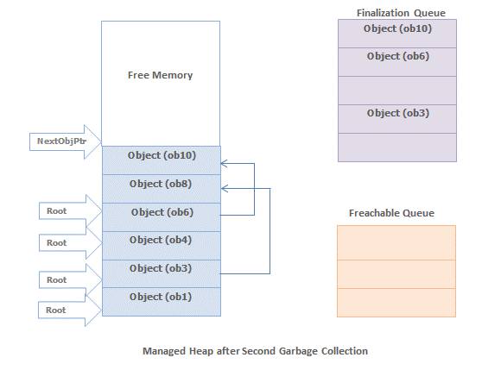
Conclusion of Finalization
Object Implement Finalizer take 2 more step to clean its memory.
So it have a performance impact.
Mainly Finalizer implement to Release or clean unmanaged resources.

Slide 15

Paid Memory Profilers
.NET Memory Profiler - http://memprofiler.com
ANTS Memory Profiler - http://www.red-gate.com/
dotmemory - http://www.jetbrains.com/
These tools have Good User Interface
Mainly dealing for memory related stuffs.

Slide 16

WinDbg
Light Weight Debugger from Microsoft
Easy to Install and Cleanup
Widely using in Unmanaged debugging
Supports both User Mode & Kernel Mode
Rich in commands
No native support for Managed debugging
Extensible
SOS - Extension for debugging managed applications

Slide 17

Installing WinDbg
As part of the WDK. Install Microsoft Visual Studio and then install the Windows Driver Kit (WDK).
As part of the Windows SDK. Install the Windows Software Development Kit (SDK).
As a standalone tool set.

Slide 18

Debugging Methods
Opening an Executable to Start Debugging
Attaching to a Running Process
Configuring an Executable to automatically attach to Debugger during the Startup.
Opening a Memory Dump to Analyze

Slide 19

Memory Dump
Snapshot of the process.
Full Dump
Call Stack at the time of taking the Dump
Register Values
Entire Address Space
Mini Dump
Call Stack at the time of taking the Dump
Register Values
Very limited Address Space

Slide 20
Creating Memory Dumps
From TaskManager
From WinDbg
.dump /f c:\mydump.dmp (creates full dump)
.dump c:\myMiniDump.dmp (creates mini dump)
ProcDump

Slide 21

SOS
Son Of Strike, Debugging extension - SOS.DLL
Formerly called as Strike which was only internal to Microsoft.
Powerful commands for static analysis compared to what VS.NET can offer.
Rich in commands to Analysis internal CLR objects including GCHeaps, Finalization Queues etc
Doesn't support source code level debugging.
Shipped with .NET Framework
Loading SOS to Windbg
.loadby sos clr (for version 4.0 of the CLR)
.loadby sos mscorwks (for version 1.0 or 2.0 of the CLR)
.load C:\Windows\Microsoft.NET\Framework64\v4.0.30319\sos.dll

Slide 22

Memory Leak
A failure in a program to release discarded memory, causing impaired performance or failure.
It is the responsibility of each application to “free” dynamically requested memory when they are finished using it.
Freeing the memory returns it to the system, where it can be re–allocated to another application when needed.
When an application dynamically allocates memory, and does not free that memory when it is finished using it, that program has a memory leak.
The memory is not being used by the application anymore, but it cannot be used by the system or any other program either.

Slide 23

Memory Leak from
Managed Code
Unmanaged Code
Use LeakDiag and LDParser tools To detect leak
http://mcfunley.com/using-leakdiag-to-debug-unmanaged-memory-leaks

Slide 24

Managed Memory Leak
Finding Which Object gets Leak ?
This can find from analyzing managed heap.
Get Managed heap statistics by windbg using !dumpheap –stat
Compare heap statistics of application start time and after make a noticeable difference in Memory.
!dumpheap -stat
Statistics:
MT Count TotalSize Class Name
706f0d78 1 12 System.Collections.Generic.GenericEqualityComparer`1[[System.Boolean, mscorlib]]
6fe46bd8 1 12 System.Reflection.CerHashtable`2[[System.Reflection.RuntimeMethodInfo, mscorlib],[System.Reflection.RuntimeMethodInfo, mscorlib]]
6fe44aa4 1 12 System.Lazy`1+Boxed[[System.Boolean, mscorlib]]
6fe43540 1 12 System.Lazy`1+Boxed[[System.Collections.Concurrent.ConcurrentDictionary`2[[System.Reflection.Assembly, mscorlib],[System.String, mscorlib]], mscorlib]]
6fe42c68 1 12 System.Collections.Generic.ObjectEqualityComparer`1[[System.Reflection.MethodInfo, mscorlib]]
6fe41ffc 1 12 System.Runtime.Remoting.Messaging.ServerContextTerminatorSink
6fe41fa4 1 12 System.Runtime.Remoting.Channels.CrossContextChannel
6fe35934 1 12 System.Threading.Tasks.ThreadPoolTaskScheduler
6fe26b54 1 12 System.Collections.Generic.ObjectEqualityComparer`1[[System.Tuple`2[[System.String, mscorlib],[System.Reflection.Assembly, mscorlib]], mscorlib]]
6fe22ca4 1 12 System.Collections.Generic.ObjectEqualityComparer`1[[System.Globalization.CultureInfo, mscorlib]]
6fe21090 1 12 System.Security.Permissions.StrongNamePublicKeyBlob
6fe15bb0 1 12 System.Security.Policy.Url

Slide 25

Finding Route Cause Object ?
Take some Type’s which used memory more.
To get Objects
!dumpheap -mt 08e7ddfc
! dumpheap –type SomeClassType
Identify it’s a dead object or Not
Take an object Address and find its GCROOT
!gcroot 1bfacf74
If No root found it’s a dead object will clear it on next GC
From gcroot we can get hierarchy of this object reference.
Analyze the gcroot reference and compare with source code conclude is it leak or not.

Slide 26

!GCROOT
!gcroot 1bfacf74
Thread 1660:
0747ef80 05caa54b Microsoft.Practices.EnterpriseLibrary.Common.Configuration.Storage.ConfigurationChangeWatcher.Poller(System.Object)
ebx:
-> 13d79c8c Microsoft.Practices.EnterpriseLibrary.Common.Configuration.Storage.ConfigurationChangeFileWatcher
-> 13d79de8 System.Threading.Thread
-> 13d68ec8 System.Runtime.Remoting.Contexts.Context
-> 13d68d30 System.AppDomain
-> 1bd75c64 System.AssemblyLoadEventHandler
-> 1bd75bec System.Web.Compilation.MemoryBuildResultCache
-> 17d5bd98 System.Threading.TimerHolder
-> 0ff1d0f0 System.Collections.Hashtable
-> 0ff1d124 System.Collections.Hashtable+bucket[]
-> 17f837a8 ASP.controls_menu_topmenu_ascx
-> 17f82780 System.Web.UI.HtmlControls.HtmlForm
-> 17f7cdc8 ASP.masterpages_masterwide_master
-> 1bf976dc ASP.pages_userlist_aspx
-> 1bfb8bdc System.Collections.ArrayList

Slide 27

Advance debugging - windbg with sos
https://blogs.msdn.microsoft.com/alejacma/2009/06/30/sos-cheat-sheet-net-2-03-03-5/
https://msdn.microsoft.com/en-us/library/bb190764(v=vs.110).aspx

Slide 28


Slide 29


